Slide 1
CIS 4296
Activity Diagrams

Slide 2

Models and Modeling
How do we define requirements? After collecting information, create models
Model– a representation of some aspect of the system being built
Unified Modeling Language (UML)
Standard graphical modeling symbols/terminology used for information systems

Slide 3
Reasons for Modeling
Learning from the modeling process
Reducing complexity by abstraction
Remembering all the details
Communicating with other development team members
Communicating with a variety of users and stakeholders
Documenting what was done for future maintenance/enhancement
A picture is worth a thousand words

Slide 4
CD3: Activity Diagrams
Workflow– sequence of processing steps that completely handles one business transaction or customer request
Activity Diagram– describes user (or system) activities, the person who does each activity, and the sequential flow of these activities
Useful for showing a graphical model of a workflow
A UML diagram

Slide 5
CD3: Activity Diagrams
The purpose of an activity diagram can be described as
Draw the activity flow of a system.
Describe the sequence from one activity to another.
Describe the parallel, branched and concurrent flow
Before drawing an activity diagram, we must have a clear understanding about the elements used in activity diagram.

Slide 6
Different types of activity diagrams
In CIS 3309/3342 you develop activity diagrams for the flow of a program
In Capstone – your activity diagrams are the flow of the entire business process
Much higher level than program flow
No add/change/delete – completely unrelated to code
May include business flow that is outside of your system
Some designations different (parallel flows, etc.)

Slide 7
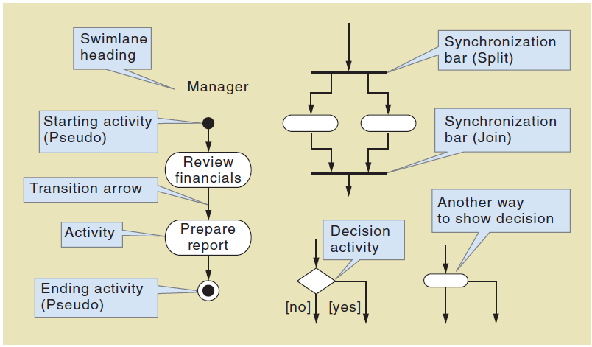
Activity Diagrams Symbols

Slide 8
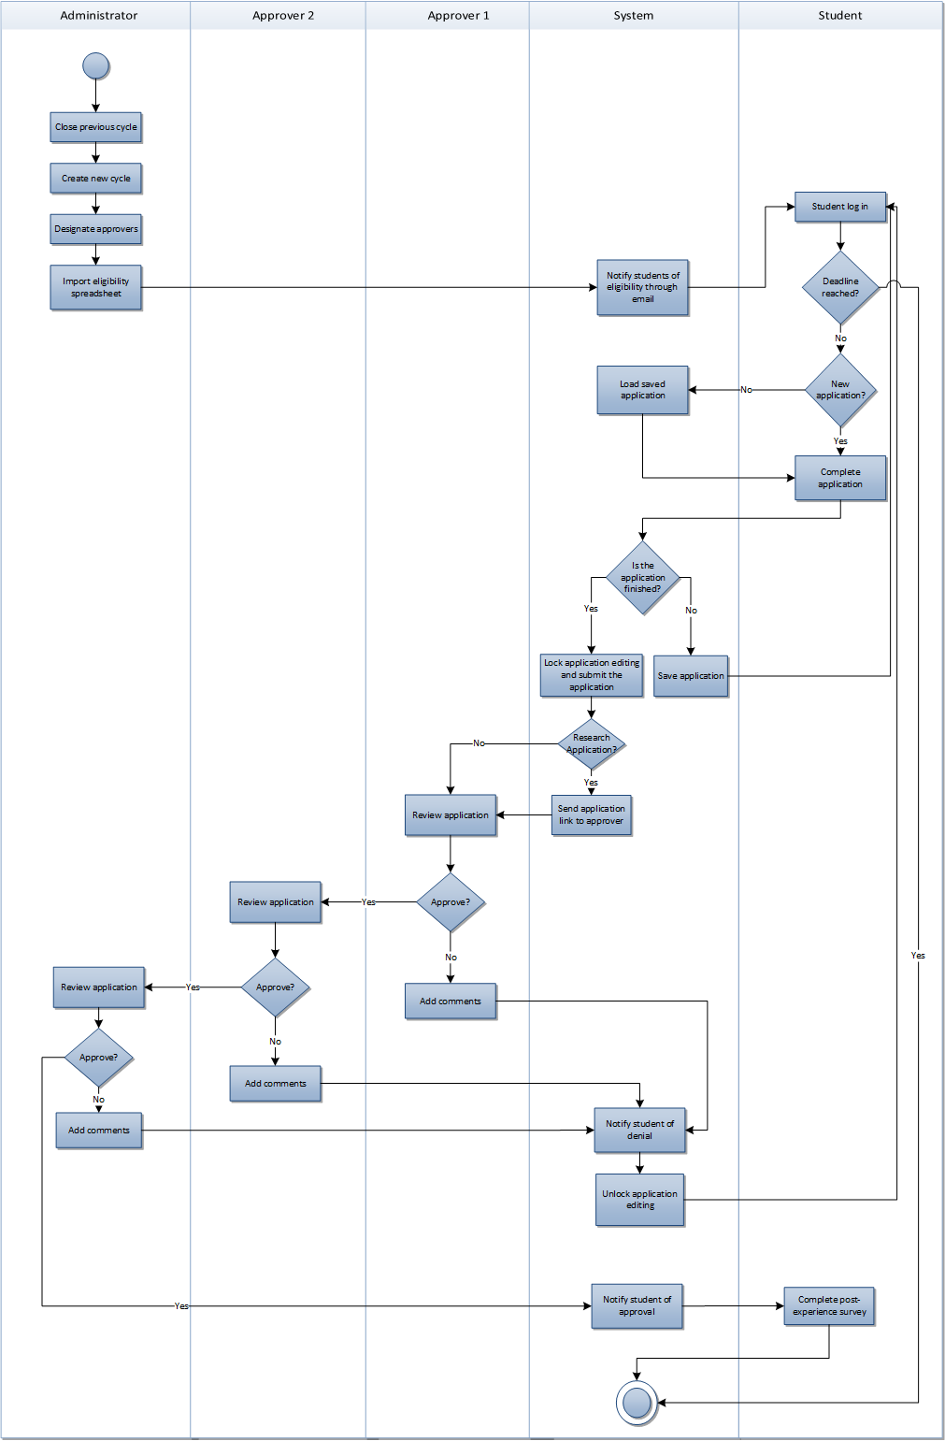

Slide 9
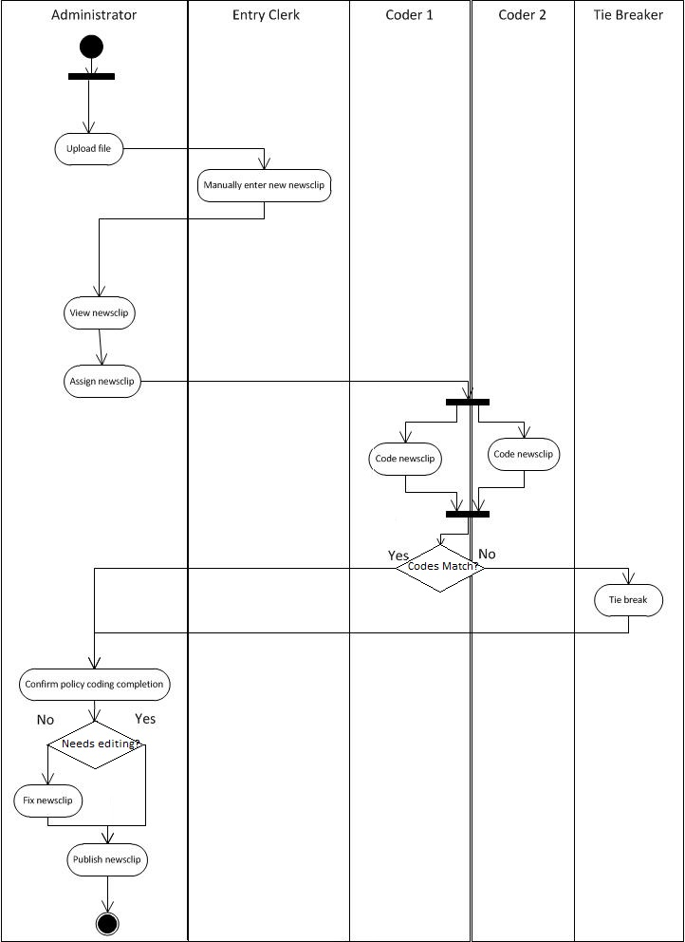
Activity Diagram with Concurrent Paths

Slide 10
Why use an activity diagram?
Model business processes
Diagram workflow
Conceptually similar to flow chart but with specific conventions
Diagram actions that occur to achieve a goal
Again – remember – we are not building an activity diagram for a program – we are still at the “20,000 foot view”

Slide 11
Building Activity Diagrams
Each person or function, and the system, get their own swimlane
One entry point (denoted with a solid circle)
One exit point (denoted with a solid circle within a larger circle)
Decision points – diamond shape – leave with a YES path and a NO path
Concurrent paths - use thick lines at beginning and end of the same-time items
VISIO is used for creating Activity Diagrams

Slide 12
